Slide 1
Managing with Big Data “at rest”, part 2
Alexander Semenov, PhD
alexander.v.semenov@jyu.fi

Slide 2
ToC
11.11.2015:
MongoDB, CouchDB
Parallel computing introduction
MapReduce introduction
Hadoop
12.11.2015
HDFS, HBase, PIG, Hive
Apache Spark
Stream processing
Apace Storm

Slide 3
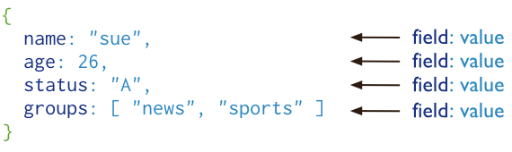
MongoDB
cross-platform document-oriented database
Stores “documents”, data structures composed of field and value pairs
Key features: high performance, high availability, automatic scaling, supports server-side JavaScript execution
Has interfaces for many programming languages
https://www.mongodb.org/
From http://www.mongodb.org/

Slide 4
MongoDB
> use mongotest
switched to db mongotest
>
> j = { name : "mongo" }
{ "name" : "mongo" }
> j
{ "name" : "mongo" }
> db.testData.insert( j )
WriteResult({ "nInserted" : 1 })
>
> db.testData.find();
{ "_id" : ObjectId("546d16f014c7cc427d660a7a"), "name" : "mongo" }
>
>
> k = { x : 3 }
{ "x" : 3 }
> show collections
system.indexes
testData
> db.testData.findOne()

Slide 5
MongoDB
> db.testData.find( { x : 18 } )
> db.testData.find( { x : 3 } )
> db.testData.find( { x : 3 } )
> db.testData.find( )
{ "_id" : ObjectId("546d16f014c7cc427d660a7a"), "name" : "mongo" }
>
> db.testData.insert( k )
WriteResult({ "nInserted" : 1 })
> db.testData.find( { x : 3 } )
{ "_id" : ObjectId("546d174714c7cc427d660a7b"), "x" : 3 }
>
> var c = db.testData.find( { x : 3 } )
> c
{ "_id" : ObjectId("546d174714c7cc427d660a7b"), "x" : 3 }

Slide 6
MongoDB
db.testData.find().limit(3)
db.testData.find( { x : {$gt:2} } )
> for(var i = 0; i < 100; i++){db.testData.insert({"x":i});}
WriteResult({ "nInserted" : 1 })
> db.testData.find( { x : {$gt:2} } )
{ "_id" : ObjectId("546d174714c7cc427d660a7b"), "x" : 3 }
{ "_id" : ObjectId("546d191514c7cc427d660a7f"), "x" : 3 }
{ "_id" : ObjectId("546d191514c7cc427d660a80"), "x" : 4 }
{ "_id" : ObjectId("546d191514c7cc427d660a81"), "x" : 5 }
{ "_id" : ObjectId("546d191514c7cc427d660a82"), "x" : 6 }
> db.testData.ensureIndex( { x: 1 } )

Slide 7
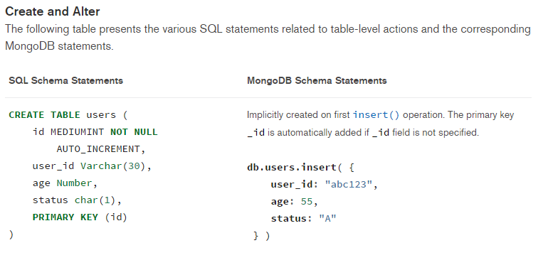
MongoDB vs SQL
https://docs.mongodb.org/manual/reference/sql-comparison/

Slide 8
Example: CouchDB, http://couchdb.org
Open source document-oriented database written mostly in the Erlang programming language
Development started in 2005
In February 2008, it became an Apache Incubator project and the license was changed to the Apache License rather than the GPL
Stores collection of JSON documents
Provides RESTFul API
Query ability is allowed via views:
Map and reduce functions

Slide 9
Example: CouchDB
When a view is queried, CouchDB takes the code of view and runs it on every document from the DB
View produces view result
Map function:
Written in JavaScript
Has single parameter – document
Can refer to document’s fields

Slide 10
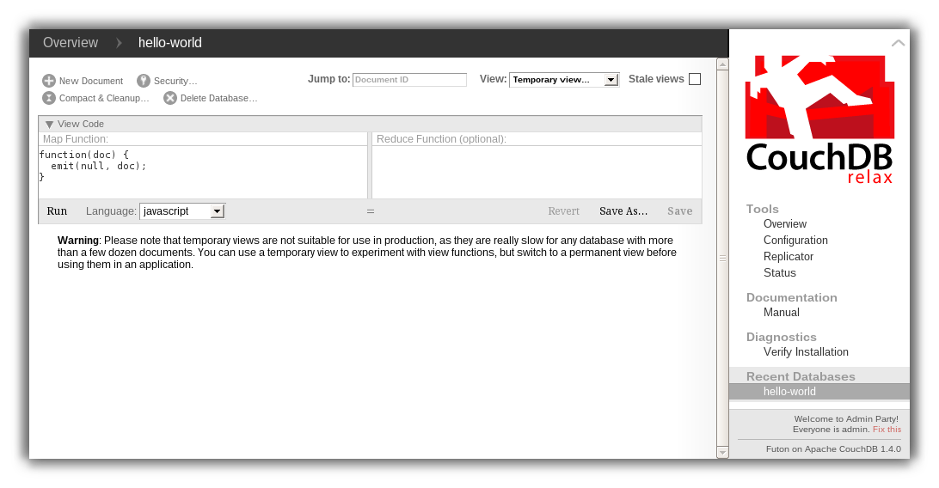
curl -X PUT http://127.0.0.1:5984/albums/6e1295ed6c29495e54cc05947f18c8af -d '{"title":"There is Nothing Left to Lose","artist":"Foo Fighters"}'

Slide 11
Example: CouchDB
"_id":"biking",
"_rev":"AE19EBC7654",
"title":"Biking",
"body":"My biggest hobby is mountainbiking. The other day...",
"date":"2009/01/30 18:04:11"
}
{
"_id":"bought-a-cat",
"_rev":"4A3BBEE711",
"title":"Bought a Cat",
"body":"I went to the the pet store earlier and brought home a little kitty...", "date":"2009/02/17 21:13:39"
} { "_id":"hello-world", "_rev":"43FBA4E7AB", "title":"Hello World", "body":"Well hello and welcome to my new blog...", "date":"2009/01/15 15:52:20" }

Slide 12
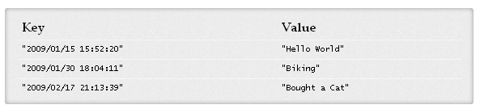
CouchDB: Example
View, Map function:
function(doc) { if(doc.date && doc.title) { emit(doc.date, doc.title); } }

Slide 13
CouchDB: Example
Map result is stored in B-tree
Reduce function operate on the sorted rows emitted by map function
Reduce function is applied to every leaf of B-tree
function(keys, values, reduce) { return sum(values); }

Slide 14
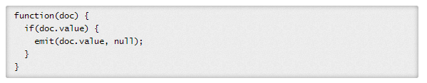
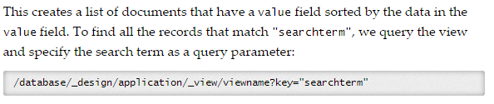
CouchDB vs SQL
http://guide.couchdb.org/draft/cookbook.html

Slide 15
Conclusions
PostgreSQL: Fixed schema, SQL query language. Database has different tables with data
MongoDB: stores JSON data, database has different collections, which store JSON documents
CouchDB: stores JSON data, database contains documents; view functions define the queries

Slide 16
Parallel computing
With horizontal scaling (scaling out) the processing is carried out on several computers same time
Parallel computing is a form of computation in which many calculations are carried out simultaneously
Large problems may be decomposed into smaller ones
Parallel computer programs are more difficult to write than sequential ones
Some algorithms can not be parallelized
Synchronization should be taken into account
increasing the degree of parallelization also increases communication costs

Slide 17
Parallel computing
Bit level parallelism
Increasing processor word size, which reduces number of instructions that processor should perform in order to process variables that did not fit into a “word” earlier: 8 bit, 16 bit, 32 bit, 64 bit
Instruction level parallelism
Several instructions may execute on one processor in parallel (if they are not dependent on each other)
Performed inside the processor
Example: sum and multiplications operations
a = x*y
b = j + k

Slide 18
Parallel computing
Data parallelism
Each processor performs same task on different parts of the data
data = [1,2,3,4];
if (proc == 1) {
process(data[0:2]);
} else if (proc == 2) {
process(data[2:4]);
}
Task parallelism
Each processor executes its own task

Slide 19
Parallel computing vs Distributed computing
Parallel computing:
Typically, all processors or cores have access to the same shared memory
Multi core, symmetric multiprocessing
Distributed computing:
Each processor has its own memory
Interconnected by a network
Communication costs are much higher, involves coordination

Slide 20

Speedup
Speedup measures increase in running time due to parallelism.
Based on running times, S(n) = t_{s}/t_{p} , where
n denotes number of CPUs
t_{s} is the execution time on a single processor, using the fastest known sequential algorithm
t_{p} is the execution time using a parallel processor.
For theoretical analysis, S(n) = t_{s}/t_{p} where
t_{s} is the worst case running time for of the fastest known sequential algorithm for the problem
t_{p} is the worst case running time of the parallel algorithm using n PEs.

Slide 21
Speedup
Maximum speedup is equal to n (number of CPU)
Superlinear speedup is also possible
Parallel system may have extra memory
Usually, the best speedup possible for most applications is much smaller than n
Usually some parts of programs are sequential and allow only one CPU to be active.
Sometimes a large number of processors are idle for certain portions of the program.
During parts of the execution, many CPUs may be waiting to receive or to send data.
E.g., blocking can occur in message passing

Slide 22
Speedup
Speedup
ideal
Super-linear
Saturation
Disaster
Number of processors

Slide 23
Amdahl's law
The speedup of a program using multiple processors in parallel computing is limited by the time needed for the sequential fraction of the program
Let f be the fraction of operations in a computation that must be performed sequentially, where 0 ≤ f ≤ 1. The maximum speedup achievable by a parallel computer with n processors is

Slide 24
Amdahl's law
Amdahl's Law approximately suggests:
“Suppose a car is traveling between two cities 60 miles apart, and has already spent one hour traveling half the distance at 30 mph. No matter how fast you drive the last half, it is impossible to achieve 90 mph average before reaching the second city. Since it has already taken you 1 hour and you only have a distance of 60 miles total; going infinitely fast you would only achieve 60 mph.”

Slide 25
Example 1
50% of a program’s have to be executed sequentially. What is the maximum possible speedup?
Basic idea: when n -> infinity, 50% will still be sequential,
while remaining 50% (parallel part) would be executed in time -> 0
Thus, it will be twice faster

Slide 26
Example 2
95% of a program’s execution time occurs inside a loop that can be executed in parallel. What is the maximum speedup we should expect from a parallel version of the program executing on 8 CPUs?

Slide 27
Parallelizability
Inherently serial problems are those problems which can not be parallelized
Computations depend on each other
Embarrassingly parallel problems can be easily decomposed into parallel tasks
No communication is required between the parts

Slide 28
Example: OpenMP
Open Multi-Processing
Library, that adds multiprocessing support to C, C++, and Fortran
http://openmp.org/
C++ version:
Offers sets of preprocessor directives
Program should be compiled with OpenMP support

Slide 29
OpenMP
int main(int argc, char *argv[]) {
const int N = 100000;
int i, a[N];
#pragma omp parallel for
for (i = 0; i < N; i++)
a[i] = 2 * i;
return 0;
}

Slide 30
OpenMP
#include <iostream>
using namespace std;
int main()
{
#pragma omp parallel {
cout<<"Hello"<<endl;
}
return 0;
}

Slide 31
Synchronization
When parallel program is being developed, typically programmer should care about synchronization
Otherwise the same data may be rewritten by parallel sections, etc
There are many mechanisms
Locks
Critical sections
Mutexes
etc

Slide 32
OpenMP
#include <iostream>
using namespace std;
int main()
{
#pragma omp parallel {
#pragma omp critical
cout<<"Hello"<<endl;
}
return 0;
}

Slide 33
MapReduce
MapReduce is a programming model and an associated implementation for processing and generating large data sets (From Jeffrey Dean and Sanjay Ghemawat, 2004)
Inspired by the map and reduce primitives present in functional languages
map and fold
MapReduce was developed by Google, described in a paper “MapReduce: Simplified Data Processing on Large Clusters”
Allows programmers without any experience with parallel and distributed systems to easily utilize the resources of a large distributed system

Slide 34
Map and fold
map takes a function f and applies it to every element in a list
Map takes single argument
fold iteratively applies a function g to aggregate results
Fold takes two arguments (first one may be 0), the second is a list
Sum of squares x^2 + y^2 + … + z^2
Map takes one parameter and squares it
Fold gets the list iteratively sums them up

Slide 35
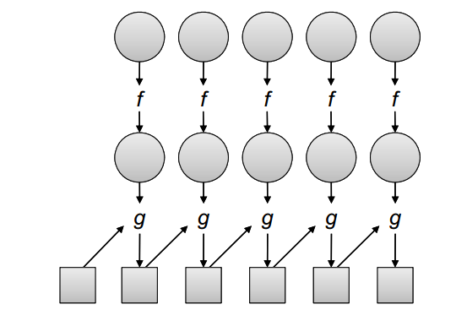
Map and Fold
http://lintool.github.io/MapReduceAlgorithms/index.html

Slide 36
MapReduce
Users specify a map and a reduce functions
map function processes a key/value pair to generate a set of intermediate key/value pairs
Shuffle and sort step:
Groups data by key, orders the values
reduce function merges all intermediate values associated with the same intermediate key
Values are in sorted order
programs written in this style are automatically parallelized and executed by a run time system

Slide 37
MapReduce
The run-time system handles
partitioning the input data
scheduling the program's execution across a set of machines
handling machine failures
managing the required inter-machine communication.
There are many implementations, one of the most popular is Apache Hadoop

Slide 38
MapReduce example
function map(String name, String document):
// name: document name
// document: document contents
for each word w in document:
emit (w, 1)
function reduce(String word, Iterator partialCounts):
// word: a word
// partialCounts: a list of aggregated partial counts
sum = 0
for each pc in partialCounts:
sum += ParseInt(pc)
emit (word, sum)

Slide 39
MapReduce example 1, word count
Input: Hello World Bye World
Hello Hadoop Goodbye Hadoop
map:
< Hello, 1>
< World, 1>
< Bye, 1>
< World, 1>
< Hello, 1>
< Hadoop, 1>
< Goodbye, 1>
< Hadoop, 1>
Shuffle:
<Hello, [1,1]> <World, [1, 1]> <Bye, [1]> <Hadoop, [1,1]> <Goodbye, [1]>
Reduce:
< Bye, 1>
< Goodbye, 1>
< Hadoop, 2>
< Hello, 2>
< World, 2>

Slide 40
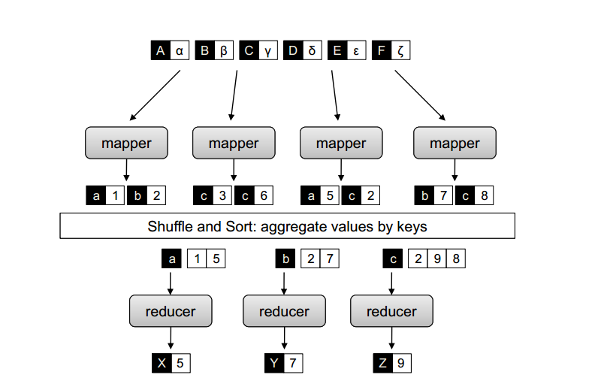
MapReduce, example 2
http://lintool.github.io/MapReduceAlgorithms/index.html

Slide 41
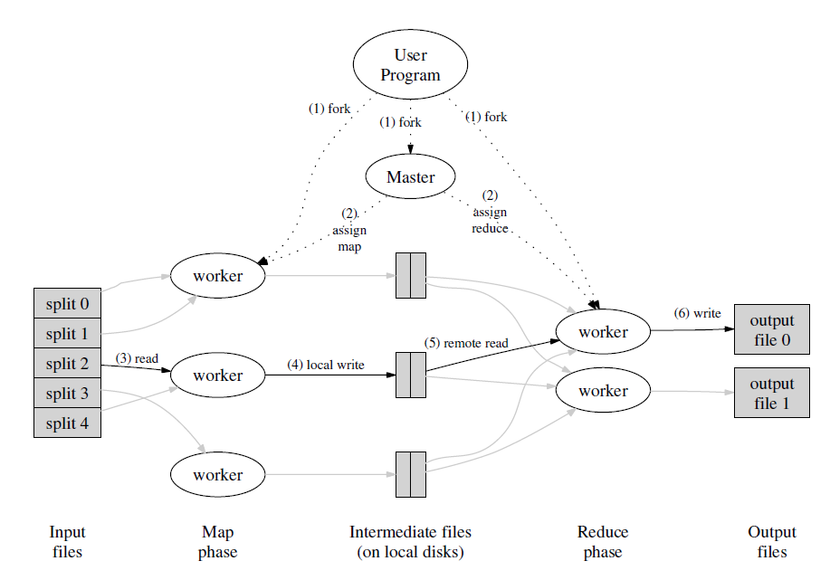
(From Jeffrey Dean and Sanjay Ghemawat, 2004)

Slide 42
Combiners
Word count emits a key-value pair for each word in the collection
all these key-value pairs need to be copied across the network
the amount of intermediate data will be larger than the input collection itself
Solution is to perform local aggregation on the output of each mapper
to compute a local count for a word over all the documents processed by the mapper
Combiner is an optimization in MapReduce that allows for local aggregation before the shuffle and sort phase
Might be viewed as “mini-reducer”
Reducer may be used as a combiner only if it is associative and commutative
In word count example reducer can be used as a combiner due to associativity and commutativity:
A+B+C = A + (B+C)
A+B = B + A

Slide 43
Partitioners
Partitioners are responsible for dividing up the intermediate key space and assigning intermediate key-value pairs to reducers
May help to handle imbalance in the amount of data associated with each key
So that each reducer would have equal number of keys

Slide 44
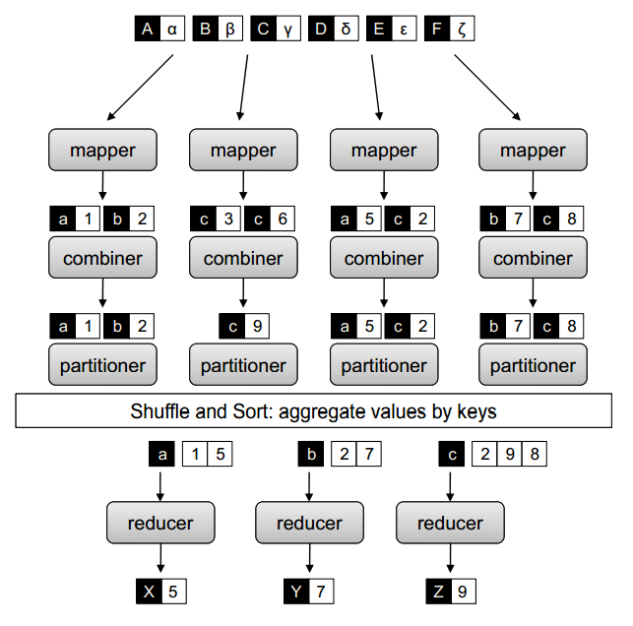
Combiners
http://lintool.github.io/MapReduceAlgorithms/MapReduce-book-final.pdf

Slide 45
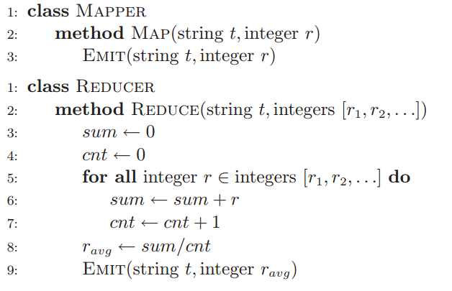
Combiner example
basic MapReduce algorithm that computes the mean of values associated with the same key
1) MapReduce for mean computation (without combiner)
From http://lintool.github.io/MapReduceAlgorithms/index.html

Slide 46

Combiner example
In mean computation, reducer cannot be used as a combiner, since

Slide 47
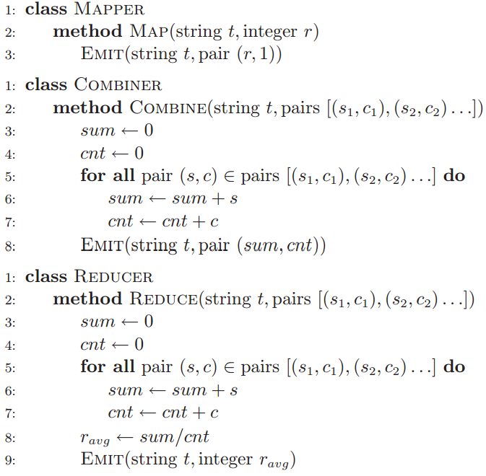
From http://lintool.github.io/MapReduceAlgorithms/index.html

Slide 48
MapReduce applications
Count of URL Access Frequency: The map function processes logs of web page requests and outputs <URL, 1>. The reduce function adds together all values for the same URL and emits a <URL, total count> pair.
ReverseWeb-Link Graph: The map function outputs <target, source> pairs for each link to a target URL found in a page named source. The reduce function concatenates the list of all source URLs associated with a given target URL and emits the pair: <target, list(source)>

Slide 49
Speculative execution
An optimization that is implemented by both Hadoop and Google’s MapReduce implementation
Idea:
the map phase of a job is only as fast as the slowest map task
Similarly, the completion time of a job is bounded by the running time of the slowest reduce task
with speculative execution, an identical copy of the same task is executed on a different machine, and the framework simply uses the result of the first task attempt to finish
Improves the results by 44% (Jeffrey Dean and Sanjay Ghemawat. MapReduce: Simplified data processing on large clusters, 2004)

Slide 50
MapReduce cluster
Machines are typically dual-processor x86 processors running Linux, with 2-4 GB of memory per machine.
Commodity networking hardware is used.  typically either 100 megabits/second or 1 gigabit/second
A cluster consists of hundreds or thousands of machines, and therefore machine failures are common.
Storage is provided by inexpensive IDE disks attached directly to individual machines. A distributed file system developed in-house is used to manage the data stored on these disks
Users submit jobs to a scheduling system.
(From Jeffrey Dean and Sanjay Ghemawat, 2004)

Slide 51
MapReduce
Data locality is important: map tasks should use data available on the present node
For some tasks partitioning is important
One of the refinements is combiner function: reduce function applied after map at each cluster

Slide 52
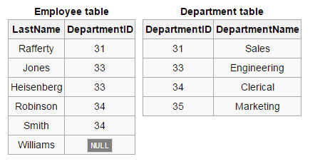
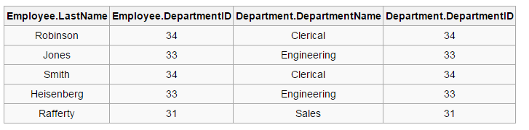
Data joins
SELECT * FROM employee JOIN department ON employee.DepartmentID = department.DepartmentID;

Slide 53
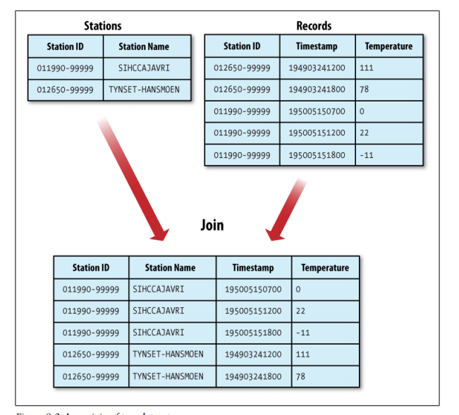

Slide 54
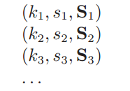
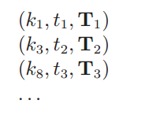
Data joins
Join may be implemented in MapReduce
Idea:
we map over both datasets and emit the join key as the intermediate key, and the tuple itself as the intermediate value
all tuples will be grouped by the join key
This is called reduce-side join

Slide 55
MapReduce algorithms
many algorithms cannot be easily expressed as a single MapReduce job
complex algorithms may be decomposed into a sequence of jobs
output of one job becomes the input to the next
repeated execution until some convergence criteria

Slide 56
MapReduce implementations
Google MapReduce
Apache Hadoop
CouchDB
targeted specifically for multi-core processors
for GPGPUs (He et al., Mars: A MapReduce framework on graphics processors,2008)
And many others

Slide 57
Apache Hadoop
Open-source software framework for distributed storage and distributed processing of Big Data on clusters of commodity hardware
Was created in 2005, developed in Java
http://Hadoop.apache.org
Consists of:
Hadoop Common: The common utilities that support the other Hadoop modules.
Hadoop Distributed File System (HDFS™): A distributed file system that provides high-throughput access to application data.
Hadoop YARN: A framework for job scheduling and cluster resource management.
Hadoop MapReduce: A YARN-based system for parallel processing of large data sets.

Slide 58
Prominent users
EBay
532 nodes cluster (8 * 532 cores, 5.3PB).
Facebook
Apache Hadoop is used to store copies of internal log and dimension data sources and use it as a source for reporting/analytics and machine learning.
2 major clusters:
A 1100-machine cluster with 8800 cores and about 12 PB raw storage.
A 300-machine cluster with 2400 cores and about 3 PB raw storage.
Each (commodity) node has 8 cores and 12 TB of storage.
http://wiki.apache.org/hadoop/PoweredBy

Slide 59
Prominent users
Last.fm
100 nodes
Dual quad-core Xeon L5520 @ 2.27GHz & L5630 @ 2.13GHz , 24GB RAM, 8TB(4x2TB)/node storage.
Used for charts calculation, royalty reporting, log analysis, A/B testing, dataset merging
LinkedIn
~800 Westmere-based HP SL 170x, with 2x4 cores, 24GB RAM, 6x2TB SATA
~1900 Westmere-based SuperMicro X8DTT-H, with 2x6 cores, 24GB RAM, 6x2TB SATA
~1400 Sandy Bridge-based SuperMicro with 2x6 cores, 32GB RAM, 6x2TB SATA
http://wiki.apache.org/hadoop/PoweredBy

Slide 60
Hadoop cluster
Hadoop cluster includes a single master and multiple worker nodes.
The master node consists of a JobTracker, TaskTracker, NameNode and DataNode
May be replicated
A slave or worker node acts as both a DataNode and TaskTracker
Data are placed in HDFS filesystem

Slide 61
Hadoop cluster
Clients submit jobs to JobTracker
JobTracker submits it to available TaskTracker nodes in the cluster
JobTracker knows which node contains the data, and which other machines are nearby
Reduces network traffic because of rack awareness

Slide 62
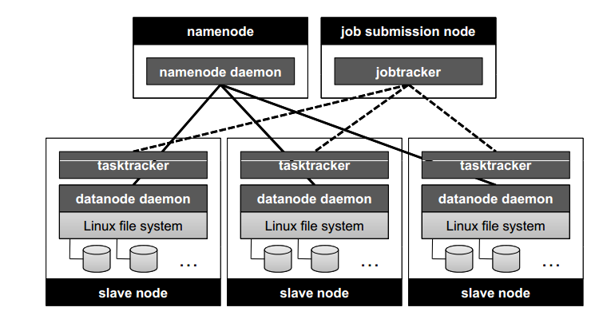
From http://lintool.github.io/MapReduceAlgorithms/index.html

Slide 63
HDFS
HDFS, The Hadoop Distributed File System
distributed file system designed to run on commodity hardware
HDFS is highly fault-tolerant
HDFS provides high throughput access to application data and is suitable for applications that have large data sets
Data in HDFS are automatically replicated
Metadata are stored in Namenode
Data are stored in Datanode
HDFS is not optimized for low-latency data access

Slide 64
HDFS
Each map task is assigned a sequence of input key-value pairs, called an input split in Hadoop.
Input splits are computed automatically and the execution framework strives to align them to HDFS block boundaries so that each map task is associated with a single data block.

Slide 65

http://hadoop.apache.org/docs/r1.2.1/hdfs_design.html

Slide 66
HBase
HBase is a column-oriented database
Runs on top of HDFS
Features
Linear and modular scalability.
Strictly consistent reads and writes.
Automatic and configurable sharding of tables

Slide 67
HBase data model
HBase organizes data into tables
Resembles SQL, but has different data model!
Row: Within a table, data is stored according to its row
Rows are identified uniquely by their row key
Column Family: Data within a row is grouped by column family.
Column families also impact the physical arrangement of data stored in HBase
Column Qualifier: Data within a column family is addressed via its column qualifier, or simply, column
Cell: A combination of row key, column family, and column qualifier uniquely identifies a cell
Values within a cell are versioned
Primary Functions: get, put, scan

Slide 68
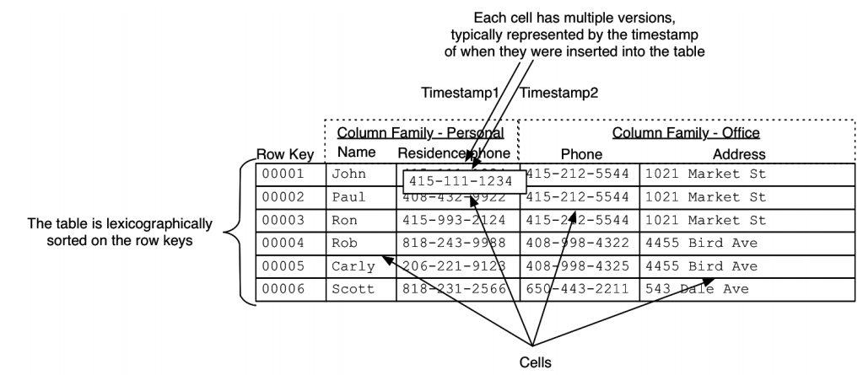
Amandeep Khurana, Introduction to HBase Schema Design, http://0b4af6cdc2f0c5998459-c0245c5c937c5dedcca3f1764ecc9b2f.r43.cf2.rackcdn.com/9353-login1210_khurana.pdf

Slide 69
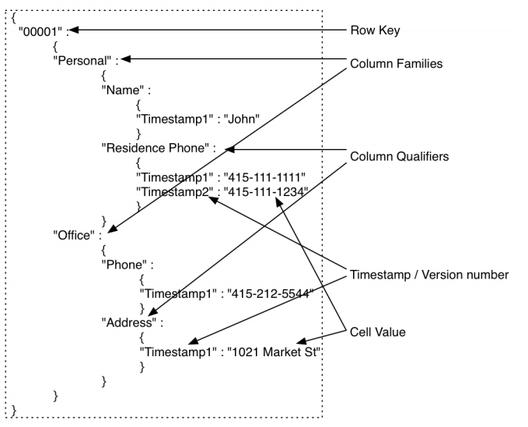
HBase row

Slide 70
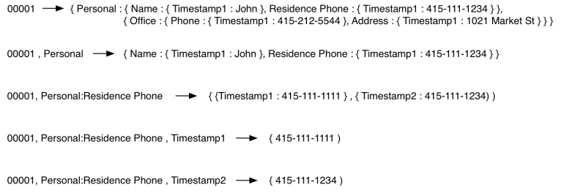
HBase row
Amandeep Khurana, Introduction to HBase Schema Design, http://0b4af6cdc2f0c5998459-c0245c5c937c5dedcca3f1764ecc9b2f.r43.cf2.rackcdn.com/9353-login1210_khurana.pdf

Slide 71
Apache Hive
Apache Hive is a data warehouse infrastructure built on top of Hadoop for providing data summarization, query, and analysis
Was originally developed by Facebook
supports analysis of large datasets stored in Hadoop's HDFS
HiveQL query language: based on SQL-92 standard but does not fully supports it
A compiler translates HiveQL statements into a directed acyclic graph of MapReduce jobs, which are submitted to Hadoop for execution
Hive should be used for batch processing, not the real time tasks!

Slide 72
HiveQL example
1)
CREATE TABLE a (k1 string, v1 string);
CREATE TABLE b (k2 string, v2 string);
SELECT k1, v1, k2, v2
FROM a JOIN b ON k1 = k2;
2)
SELECT a.* FROM a JOIN b ON (a.id = b.id AND a.department = b.department)

Slide 73
Apache Pig
Pig raises the level of abstraction for processing large datasets
Pig was originally developed by yahoo
Pig consists of:
The language used to express data flows, called Pig Latin.
The execution environment to run Pig Latin programs.
Pig turns the transformations into a series of MapReduce jobs

Slide 74
Apache Pig
-- max_temp.pig: Finds the maximum temperature by year
records = LOAD 'input/ncdc/micro-tab/sample.txt'
AS (year:chararray, temperature:int, quality:int);
filtered_records = FILTER records BY temperature != 9999 AND
(quality == 0 OR quality == 1 OR quality == 4 OR quality == 5 OR quality == 9);
grouped_records = GROUP filtered_records BY year;
max_temp = FOREACH grouped_records GENERATE group,
MAX(filtered_records.temperature);
DUMP max_temp;

Slide 75
Apache Pig
DESCRIBE records;
>> records: {year: chararray,temperature: int,quality: int}
DUMP grouped_records;
>> (1949,{(1949,111,1),(1949,78,1)})
(1950,{(1950,0,1),(1950,22,1),(1950,-11,1)})
DESCRIBE grouped_records;
>> grouped_records: {group: chararray,filtered_records: {year: chararray,
temperature: int,quality: int}}

Slide 76
Apache Pig
input_lines = LOAD '/tmp/my-copy-of-all-pages-on-internet' AS (line:chararray);
-- Extract words from each line and put them into a pig bag
-- datatype, then flatten the bag to get one word on each row
words = FOREACH input_lines GENERATE FLATTEN(TOKENIZE(line)) AS word;
-- filter out any words that are just white spaces
filtered_words = FILTER words BY word MATCHES '\\w+';
-- create a group for each word
word_groups = GROUP filtered_words BY word;
-- count the entries in each group
word_count = FOREACH word_groups GENERATE COUNT(filtered_words) AS count, group AS word;
-- order the records by count
ordered_word_count = ORDER word_count BY count DESC;
STORE ordered_word_count INTO '/tmp/number-of-words-on-internet';

Slide 77
Apache Spark
Is a cluster computing platform designed to be fast and general purpose
extends the popular MapReduce model
Developed in the University of California, Berkeley
Development started in 2004
In 2013 the project was donated to Apache Software Foundation
http://spark.apache.org/
Book: Holden Karau, Andy Konwinski, Patrick Wendell & Matei Zaharia, Learning Spark, 2015

Slide 78
Apache Spark, key features
Run programs up to 100x faster than Hadoop MapReduce in memory, or 10x faster on disk.
Write applications quickly in Java, Scala, Python, R.
Contains API and shell
Combine SQL, streaming, and complex analytics.
Contains libraries, e.g. machine learning and graph processing

Slide 79
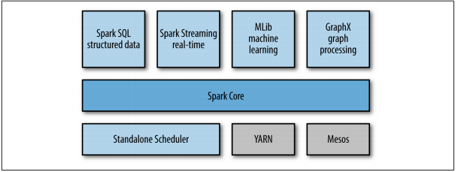
Spark architecture
From Holden Karau, Andy Konwinski, Patrick Wendell & Matei Zaharia, Learning Spark, 2015

Slide 80
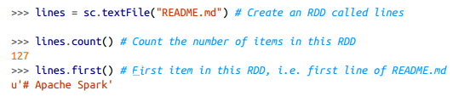
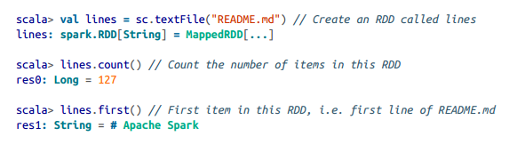
Examples
Python shell, word count
Scala shell, word count
From Holden Karau, Andy Konwinski, Patrick Wendell & Matei Zaharia, Learning Spark, 2015

Slide 81
Core concepts
Primary abstraction is Resilient Distributed Dataset (RDD)
Can be initialized with data, e.g. from CSV file, from database, etc
Later, different operations can be applied to RDD.
RDD operations
Transformations: return new RDD
Actions: operations that return a final value to the driver program or write data to an external storage system
Spark’s RDDs are by default recomputed each time you run an action on them
RDD.persist() can be used to keep RDD in memory

Slide 82
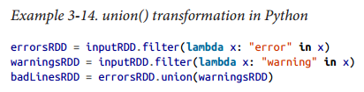
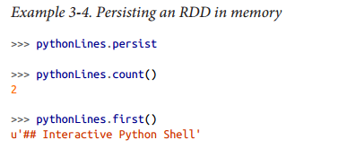
Example: union transformation
Persisting RDD in memory
From Holden Karau, Andy Konwinski, Patrick Wendell & Matei Zaharia, Learning Spark, 2015

Slide 83
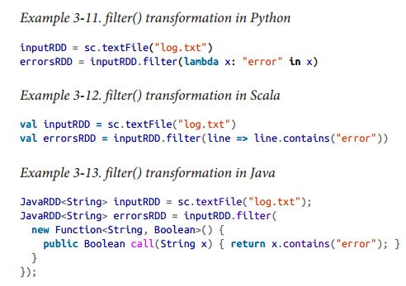
Example: filter transformation
From Holden Karau, Andy Konwinski, Patrick Wendell & Matei Zaharia, Learning Spark, 2015

Slide 84
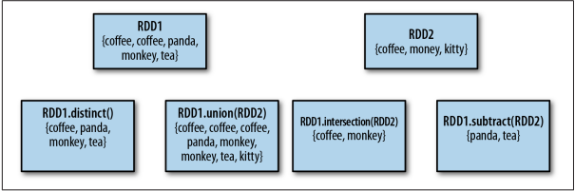
Common RDD operations
map – applies function to all RDD elements
filter - returns only those elements which adhere to filter
Set operations: union, subtract, distinct, intersection
From Holden Karau, Andy Konwinski, Patrick Wendell & Matei Zaharia, Learning Spark, 2015

Slide 85
Common RDD operations
reduce
takes a function that operates on two elements of the type in your RDD and returns a new element of the same type
sum = rdd.reduce(lambda x, y: x + y)
Aggregate
take(n) – returns subset of n elements of RDD
collect – returns all RDD elements
count, countByValue

Slide 86
Key-Value pairs operations
reduceByKey(func)
Combines values with the same key
groupByKey()
Group values with the same key.
keys()
Return an RDD of just the keys.
Join operations:
Inner join, rightOuterJoin, leftOuterJoin

Slide 87
Stream processing
Stream processing is designed to analyze and act on real-time streaming data, using “continuous queries”
i.e. SQL-type queries that operate over time and buffer windows.
“Big Data” vs “Fast Data”
Essential to stream processing is streaming analytics, or the ability to continuously calculate mathematical or statistical analytics on the fly within the stream
Often, sampling and approximate algorithms are applied

Slide 88
Stream examples
Network of sensors
Assume one sensor generates 4 bytes of data per 0.1 second (for example temperature)
3.5 MB per day
Then, 1 million of sensors would produce 3.5 TB per day
Query examples: maximum temperature, average temperature
Web traffic
User search queries

Slide 89
Stream processing
Whole dataset can not be stored and accessed fast
Standing queries: permanently executing queries
E.g. Maximum temperature
Ad hoc queries:
a question asked once about the current state of a stream or streams
May use limited working storage with e.g. time window of a stream

Slide 90
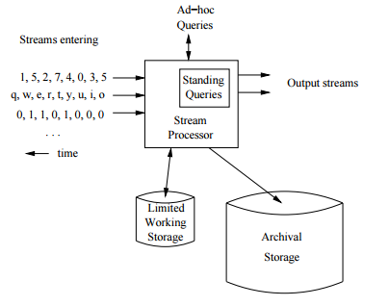
A data stream management system
From http://infolab.stanford.edu/~ullman/mmds/book.pdf

Slide 91
Stream processing examples
Algorithmic trading
300 securities firms and hedge funds that specialize in this type of trading took in a maximum of US$21 billion in profits in 2008
In the U.S., high-frequency trading (HFT) firms represent 2% of the approximately 20,000 firms operating today, but account for 73% of all equity trading volume
computers that execute trades within microseconds, or "with extremely low latency"
light 3.3 milliseconds per 1,000 kilometers of optical fiber
Book: Flash boys, Michael Lewis, 2014

Slide 92


Slide 93
Apache Storm
Hadoop was designed for batch processing, not for the realtime
Apache Storm is an open source framework that provides massively scalable event collection.
was created by Twitter
https://storm.apache.org/
Implemented in Java and Closure

Slide 94
Apache Storm
Broad set of use cases
Storm can be used for processing messages and updating databases (stream processing), doing a continuous query on data streams and streaming the results into clients (continuous computation), parallelizing an intense query like a search query on the fly (distributed RPC), and more. Storm's small set of primitives satisfy a stunning number of use cases.
Scalable
scales to massive numbers of messages per second. To scale a topology, all you have to do is add machines and increase the parallelism settings of the topology. As an example of Storm's scale, one of Storm's initial applications processed 1,000,000 messages per second on a 10 node cluster, including hundreds of database calls per second as part of the topology. Storm's usage of Zookeeper for cluster coordination makes it scale to much larger cluster sizes.
Guarantees no data loss
A realtime system must have strong guarantees about data being successfully processed. A system that drops data has a very limited set of use cases. Storm guarantees that every message will be processed, and this is in direct contrast with other systems .

Slide 95
Apache Storm
Extremely robust
Unlike systems like Hadoop, which are notorious for being difficult to manage, Storm clusters just work. It is an explicit goal of the Storm project to make the user experience of managing Storm clusters as painless as possible.
Fault-tolerant
If there are faults during execution of your computation, Storm will reassign tasks as necessary. Storm makes sure that a computation can run forever (or until you kill the computation).
Programming language agnostic
Robust and scalable realtime processing shouldn't be limited to a single platform. Storm topologies and processing components can be defined in any language, making Storm accessible to nearly anyone.

Slide 96
Apache Storm
A stream is an unbounded sequence of tuples
Basic primitives are are "spouts" and "bolts“
Spouts and bolts have interfaces that programmer implements to run application-specific logic.
A spout may connect to the Twitter API and emit a stream of tweets
A bolt consumes any number of input streams, does some processing, and possibly emits new streams.
Complex stream transformations, like computing a stream of trending topics from a stream of tweets, require multiple steps and thus multiple bolts
Spouts and bolts are connected in topology
Topology is directed acyclic graph

Slide 97
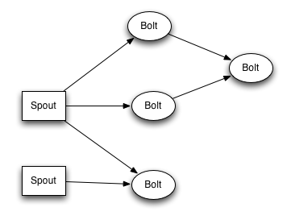
From http://storm.apache.org/tutorial.html

Slide 98
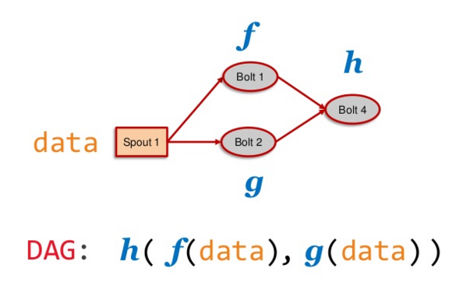
From http://www.slideshare.net/miguno/apache-storm-09-basic-training-verisign

Slide 99
Thank You!

